Slide 1

COMPUTER ORGANIZATION AND ARCHITECTURE
NAME- RUPAK SARKAR
ROLL NO- 14271024036

Slide 2
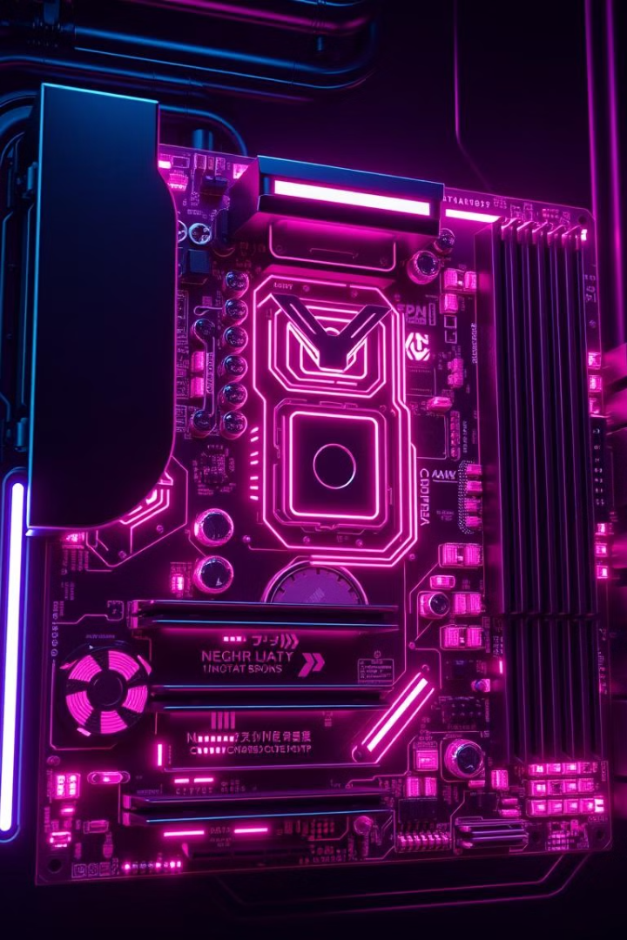
Delving into Computer Architecture
This presentation will explore the fundamentals of computer architecture, examining its key components and their interworking.

Slide 3
Understanding Computer Organization
The Blueprint
Interconnected Systems
Computer organization defines the structural relationships between the hardware components, outlining how data flows and instructions are executed. It acts as the blueprint for building a computer.
Think of it as the framework of a house - it sets the foundation for the individual components to work together efficiently and achieve a common goal, which is to process information.

Slide 4
Fundamental Components of a Computer System
Input Unit
ALU (Arithmetic Logic Unit)
The gateway for information into the computer system. It receives data from external devices, converts it to a usable format, and sends it to the processing unit.
The brain of the computer, performing mathematical calculations and logical operations on the data received. It handles all the core processing work, ensuring smooth and accurate computations.
Memory Unit
Control Unit
The system's temporary storage space, holding data and instructions for the CPU to access quickly. It's the computer's short-term memory, essential for rapid retrieval and processing.
The director of the computer system. It interprets instructions, coordinates the activities of other components, and manages the flow of data within the system.
Output Unit
CPU (Central Processing Unit)
The system's output channel, presenting processed results to the user in a readable format. It transforms digital information into visual, audio, or printed output.
The heart of the computer. It comprises the ALU and Control Unit, working together to execute instructions, process data, and ultimately drive the system's functionality.

Slide 5
Defining the Input Unit, ALU, and Memory Unit
Input Unit
ALU (Arithmetic Logic Unit)
Memory Unit
The input unit is the interface between the computer and the outside world. It captures data from external sources, such as keyboards, mice, scanners, and microphones, and transforms it into a digital format suitable for the computer to process.
The memory unit is the temporary storage space within the computer. It stores data and instructions that the CPU needs to access quickly. It's a crucial component that facilitates efficient processing and allows the computer to work with information rapidly.
The ALU performs the fundamental operations of the computer. It calculates arithmetic operations like addition, subtraction, multiplication, and division, as well as logical operations like comparisons, and boolean logic.

Slide 6
Defining the Central Unit, Output Unit, and Central Processing Unit
Central Unit
Output Unit
CPU (Central Processing Unit)
The central unit encompasses the CPU, memory unit, and control unit, forming the heart of the computer system. These components work in harmony to process data, store instructions, and manage the overall flow of information.
The output unit acts as the system's communication channel to the user. It takes processed data from the CPU and presents it in a readable format through devices like monitors, printers, speakers, and other output devices.
The CPU, often referred to as the brain of the computer, is the central processing unit that executes instructions, performs calculations, and ultimately controls the system's operations. It's the core component that makes the computer function.

Slide 7
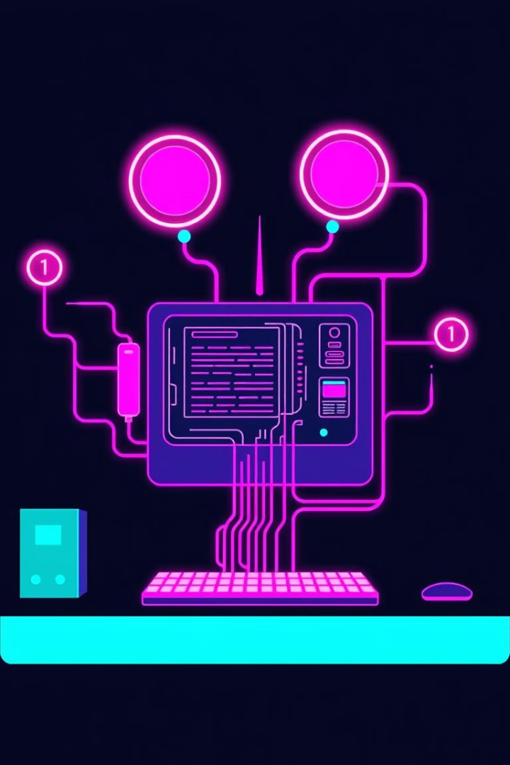


Key Takeaways
Understanding Hardware
Relationship of Parts
We explored the crucial components of a computer system - input, ALU, memory, control, output, and CPU.
These components work together, forming the intricate structure and functionality of a computer.

Slide 8


Thank You!

